Slide 1

Universal Automation: Overview and Introduction
Josh King
@WindosNZ

Slide 2

What is Universal Automation?
“The ultra fast, simple and lightweight
automation platform for PowerShell.”
@WindosNZ

Slide 3
But… How?
Background Jobs
Scheduling
PowerShell Focused
Persistence
Git Integrations
Dashboard
@WindosNZ

Slide 4
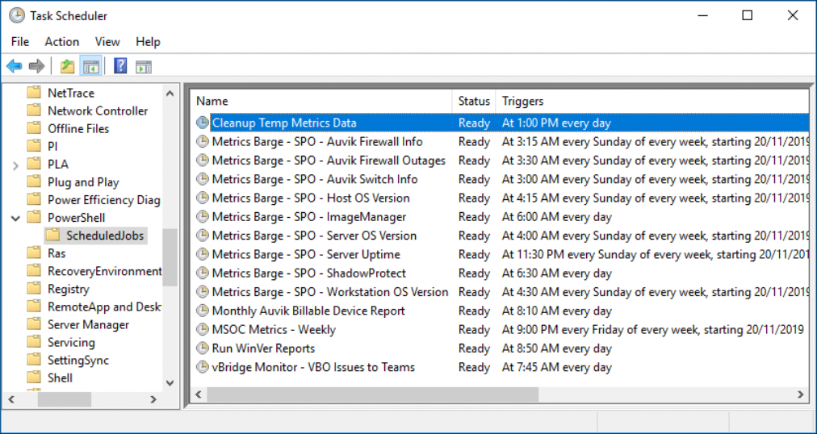
@WindosNZ

Slide 5
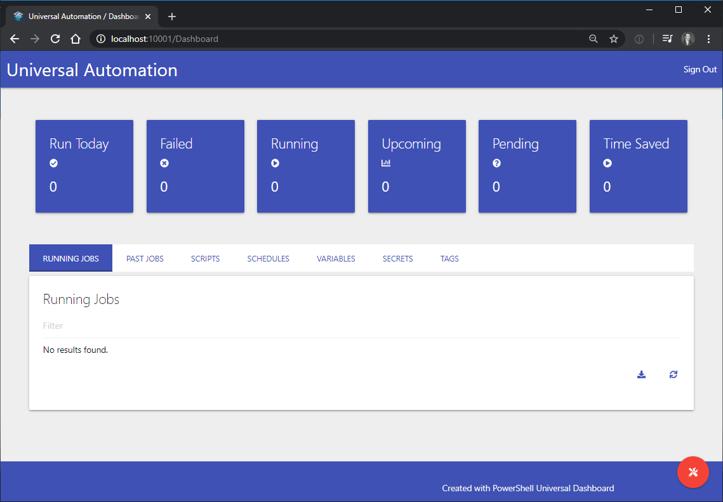
@WindosNZ

Slide 6
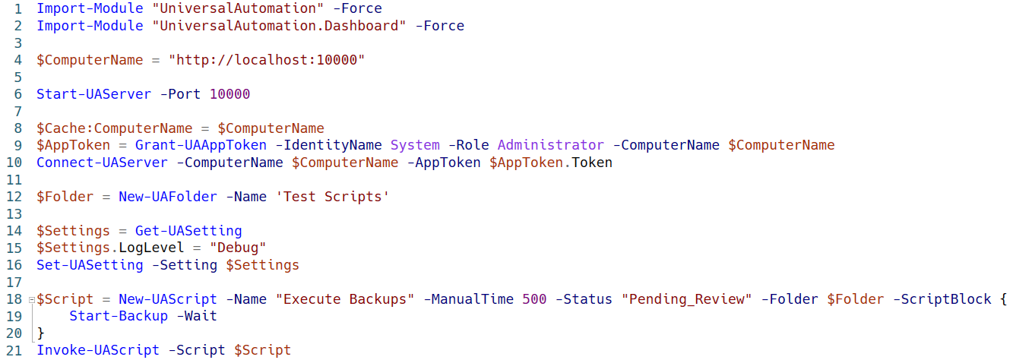
@WindosNZ

Slide 7
Demo
@WindosNZ

Slide 8




Git = Not Remoting onto the Server
Git Remote
(GitHub or Other)
Your Workstation
Universal Automation
Icons by srip on flaticon.com
@WindosNZ

Slide 9
Sold?
Info, Docs, and Purchase: universalautomation.io
Cost: $99.99 USD
(No… I don’t get a commission!)
@WindosNZ

Slide 10
Just Want to Play?
Run up to 3 concurrent jobs
Max 100 jobs/day
@WindosNZ

Slide 11
Thank You!
bit.ly/link
@WindosNZ

